Slide 1
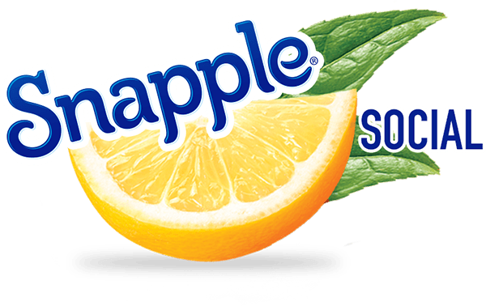
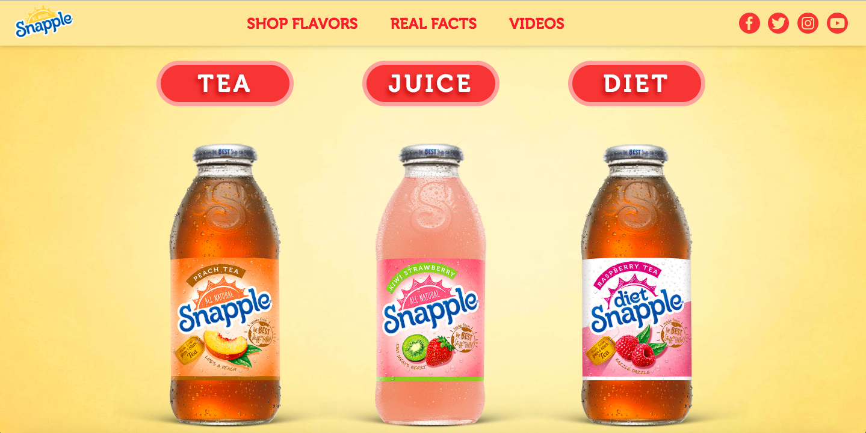
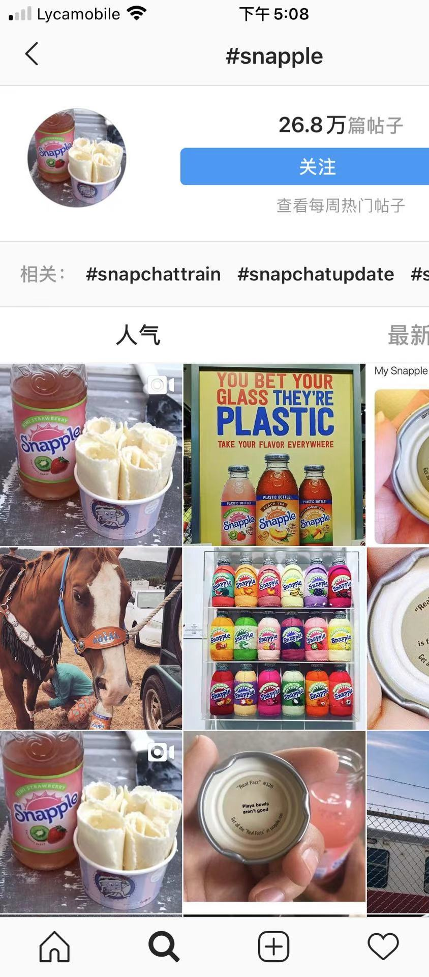
Snapple
Advertising Plan
Group 3
Dan Lou, Xinyi Wu, Minna Fang, Jiaxin Liu

Slide 2
Introduction
INTRO
INTRO
INTRO
INTRO
INTRO
INTRO
INTRO
INTRO
MARKETING
PROBLEM
MARKETING
PROBLEM
MARKETING
PROBLEM
MARKETING
PROBLEM
MARKETING
PROBLEM
MARKETING
PROBLEM
MARKETING
PROBLEM
MARKETING
PROBLEM
ADVERTISING
OBJECTIVE
ADVERTISING
OBJECTIVE
ADVERTISING
OBJECTIVE
ADVERTISING
OBJECTIVE
ADVERTISING
OBJECTIVE
ADVERTISING
OBJECTIVE
ADVERTISING
OBJECTIVE
ADVERTISING
OBJECTIVE
SITUATION ANALYSIS
SITUATION ANALYSIS
SITUATION ANALYSIS
SITUATION ANALYSIS
SITUATION ANALYSIS
SITUATION ANALYSIS
SITUATION ANALYSIS
SITUATION ANALYSIS
TREND
TREND
TREND
TREND
TREND
TREND
TREND
TREND
COMPETITIVE
COMPETITIVE
COMPETITIVE
COMPETITIVE
COMPETITIVE
COMPETITIVE
COMPETITIVE
COMPETITIVE
TARGET AUDIENCE
TARGET AUDIENCE
TARGET AUDIENCE
TARGET AUDIENCE
TARGET AUDIENCE
TARGET AUDIENCE
TARGET AUDIENCE
TARGET AUDIENCE
CONSUMER INSIGHTS
CONSUMER INSIGHTS
CONSUMER INSIGHTS
CONSUMER INSIGHTS
CONSUMER INSIGHTS
CONSUMER INSIGHTS
CONSUMER INSIGHTS
CONSUMER INSIGHTS
CREATIVE
BRIEF
CREATIVE
EXECUTION
CREATIVE
EXECUTION
CREATIVE
EXECUTION
CREATIVE
EXECUTION
CREATIVE
EXECUTION
CREATIVE
EXECUTION
CREATIVE
EXECUTION
CREATIVE
EXECUTION
MEDIA
PLAN
MEDIA
PLAN
MEDIA
PLAN
MEDIA
PLAN
MEDIA
PLAN
MEDIA
PLAN
MEDIA
PLAN
MEDIA
PLAN
The advertising plan is designed for Snapple company, in order to solve its current problem, changing consumer's perception of its product.
The advertising plan covers 9 major parts, including marketing problem, advertising objectives, situation analysis, trend analysis, competitive analysis, target audience, consumer thoughts, creative execution and media plan.
The overall goal is to increase the market share of Snapple and increase the sales of Snapple’s products.

Slide 3
Marketing Problem
INTRO
INTRO
INTRO
INTRO
INTRO
INTRO
INTRO
INTRO
MARKETING
PROBLEM
MARKETING
PROBLEM
MARKETING
PROBLEM
MARKETING
PROBLEM
MARKETING
PROBLEM
MARKETING
PROBLEM
MARKETING
PROBLEM
MARKETING
PROBLEM
ADVERTISING
OBJECTIVE
ADVERTISING
OBJECTIVE
ADVERTISING
OBJECTIVE
ADVERTISING
OBJECTIVE
ADVERTISING
OBJECTIVE
ADVERTISING
OBJECTIVE
ADVERTISING
OBJECTIVE
ADVERTISING
OBJECTIVE
SITUATION ANALYSIS
SITUATION ANALYSIS
SITUATION ANALYSIS
SITUATION ANALYSIS
SITUATION ANALYSIS
SITUATION ANALYSIS
SITUATION ANALYSIS
SITUATION ANALYSIS
TREND
TREND
TREND
TREND
TREND
TREND
TREND
TREND
COMPETITIVE
COMPETITIVE
COMPETITIVE
COMPETITIVE
COMPETITIVE
COMPETITIVE
COMPETITIVE
COMPETITIVE
TARGET AUDIENCE
TARGET AUDIENCE
TARGET AUDIENCE
TARGET AUDIENCE
TARGET AUDIENCE
TARGET AUDIENCE
TARGET AUDIENCE
TARGET AUDIENCE
CONSUMER INSIGHTS
CONSUMER INSIGHTS
CONSUMER INSIGHTS
CONSUMER INSIGHTS
CONSUMER INSIGHTS
CONSUMER INSIGHTS
CONSUMER INSIGHTS
CONSUMER INSIGHTS
CREATIVE
BRIEF
CREATIVE
EXECUTION
CREATIVE
EXECUTION
CREATIVE
EXECUTION
CREATIVE
EXECUTION
CREATIVE
EXECUTION
CREATIVE
EXECUTION
CREATIVE
EXECUTION
CREATIVE
EXECUTION
MEDIA
PLAN
MEDIA
PLAN
MEDIA
PLAN
MEDIA
PLAN
MEDIA
PLAN
MEDIA
PLAN
MEDIA
PLAN
MEDIA
PLAN
Snapple was once the leading competitor in the ready-to-drink iced tea category.
Heightened competition and diminishing media presence has caused consumers to overlook Snapple for more contemporary iced tea brands.

Slide 4
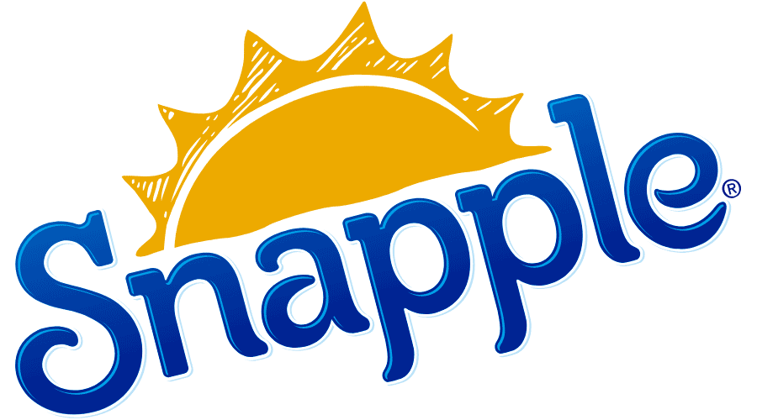
Advertising Objective
INTRO
INTRO
INTRO
INTRO
INTRO
INTRO
INTRO
MARKETING
PROBLEM
MARKETING
PROBLEM
MARKETING
PROBLEM
MARKETING
PROBLEM
MARKETING
PROBLEM
MARKETING
PROBLEM
MARKETING
PROBLEM
ADVERTISING
OBJECTIVE
ADVERTISING
OBJECTIVE
ADVERTISING
OBJECTIVE
ADVERTISING
OBJECTIVE
ADVERTISING
OBJECTIVE
ADVERTISING
OBJECTIVE
ADVERTISING
OBJECTIVE
SITUATION ANALYSIS
SITUATION ANALYSIS
SITUATION ANALYSIS
SITUATION ANALYSIS
SITUATION ANALYSIS
SITUATION ANALYSIS
SITUATION ANALYSIS
TREND
TREND
TREND
TREND
TREND
TREND
TREND
COMPETITIVE
COMPETITIVE
COMPETITIVE
COMPETITIVE
COMPETITIVE
COMPETITIVE
COMPETITIVE
TARGET AUDIENCE
TARGET AUDIENCE
TARGET AUDIENCE
TARGET AUDIENCE
TARGET AUDIENCE
TARGET AUDIENCE
TARGET AUDIENCE
CONSUMER INSIGHTS
CONSUMER INSIGHTS
CONSUMER INSIGHTS
CONSUMER INSIGHTS
CONSUMER INSIGHTS
CONSUMER INSIGHTS
CONSUMER INSIGHTS
CREATIVE
BRIEF
CREATIVE
EXECUTION
CREATIVE
EXECUTION
CREATIVE
EXECUTION
CREATIVE
EXECUTION
CREATIVE
EXECUTION
CREATIVE
EXECUTION
CREATIVE
EXECUTION
MEDIA
PLAN
MEDIA
PLAN
MEDIA
PLAN
MEDIA
PLAN
MEDIA
PLAN
MEDIA
PLAN
MEDIA
PLAN
Change consumer perception of Snapple to be more positive and fashion.

Slide 5
Situation Analysis: Brief Overview
INTRO
INTRO
INTRO
INTRO
INTRO
INTRO
INTRO
MARKETING
PROBLEM
MARKETING
PROBLEM
MARKETING
PROBLEM
MARKETING
PROBLEM
MARKETING
PROBLEM
MARKETING
PROBLEM
MARKETING
PROBLEM
ADVERTISING
OBJECTIVE
ADVERTISING
OBJECTIVE
ADVERTISING
OBJECTIVE
ADVERTISING
OBJECTIVE
ADVERTISING
OBJECTIVE
ADVERTISING
OBJECTIVE
ADVERTISING
OBJECTIVE
SITUATION ANALYSIS
SITUATION ANALYSIS
SITUATION ANALYSIS
SITUATION ANALYSIS
SITUATION ANALYSIS
SITUATION ANALYSIS
SITUATION ANALYSIS
TREND
TREND
TREND
TREND
TREND
TREND
TREND
COMPETITIVE
COMPETITIVE
COMPETITIVE
COMPETITIVE
COMPETITIVE
COMPETITIVE
COMPETITIVE
TARGET AUDIENCE
TARGET AUDIENCE
TARGET AUDIENCE
TARGET AUDIENCE
TARGET AUDIENCE
TARGET AUDIENCE
TARGET AUDIENCE
CONSUMER INSIGHTS
CONSUMER INSIGHTS
CONSUMER INSIGHTS
CONSUMER INSIGHTS
CONSUMER INSIGHTS
CONSUMER INSIGHTS
CONSUMER INSIGHTS
CREATIVE
BRIEF
CREATIVE
EXECUTION
CREATIVE
EXECUTION
CREATIVE
EXECUTION
CREATIVE
EXECUTION
CREATIVE
EXECUTION
CREATIVE
EXECUTION
CREATIVE
EXECUTION
MEDIA
PLAN
MEDIA
PLAN
MEDIA
PLAN
MEDIA
PLAN
MEDIA
PLAN
MEDIA
PLAN
MEDIA
PLAN
Snapple Overview:
A brand of tea and juice drinks / Owned by Keurig Dr. Pepper
Founded in 1972 / Privately held / Based in Plano, Texas
The brand achieved some fame due to various pop-culture references including television shows.
Sales:
2016: 58.6 million 2017: 56.1million
In 2018, 54.6 million 192 oz cases of Snapple Tea were sold in the United States.
*Sales declined by 4 million in the past two years.
https://finance.yahoo.com/quote/DPS/profile?p=DPS
https://www.statista.com/statistics/941877/snapple-tea-sales-volume-us/

Slide 6
Situation Analysis: Product and Price
INTRO
INTRO
INTRO
INTRO
INTRO
INTRO
INTRO
MARKETING
PROBLEM
MARKETING
PROBLEM
MARKETING
PROBLEM
MARKETING
PROBLEM
MARKETING
PROBLEM
MARKETING
PROBLEM
MARKETING
PROBLEM
ADVERTISING
OBJECTIVE
ADVERTISING
OBJECTIVE
ADVERTISING
OBJECTIVE
ADVERTISING
OBJECTIVE
ADVERTISING
OBJECTIVE
ADVERTISING
OBJECTIVE
ADVERTISING
OBJECTIVE
SITUATION ANALYSIS
SITUATION ANALYSIS
SITUATION ANALYSIS
SITUATION ANALYSIS
SITUATION ANALYSIS
SITUATION ANALYSIS
SITUATION ANALYSIS
TREND
TREND
TREND
TREND
TREND
TREND
TREND
COMPETITIVE
COMPETITIVE
COMPETITIVE
COMPETITIVE
COMPETITIVE
COMPETITIVE
COMPETITIVE
TARGET AUDIENCE
TARGET AUDIENCE
TARGET AUDIENCE
TARGET AUDIENCE
TARGET AUDIENCE
TARGET AUDIENCE
TARGET AUDIENCE
CONSUMER INSIGHTS
CONSUMER INSIGHTS
CONSUMER INSIGHTS
CONSUMER INSIGHTS
CONSUMER INSIGHTS
CONSUMER INSIGHTS
CONSUMER INSIGHTS
CREATIVE
BRIEF
CREATIVE
EXECUTION
CREATIVE
EXECUTION
CREATIVE
EXECUTION
CREATIVE
EXECUTION
CREATIVE
EXECUTION
CREATIVE
EXECUTION
CREATIVE
EXECUTION
MEDIA
PLAN
MEDIA
PLAN
MEDIA
PLAN
MEDIA
PLAN
MEDIA
PLAN
MEDIA
PLAN
MEDIA
PLAN
III. Product
Snapple manufactures numerous non-carbonated drinks like regular and diet tea, bottled water, lemonade, and juice drinks. They are projected as premium products with diverse flavors.
IV. Price
$1.38/16 oz (1 bottle)
Follows the competitive strategy in order to mark a price on their products.
Its products are generally a little cheaper in comparison to its competitors – Coca-Cola, Pepsi.
https://www.drpeppersnapplegroup.com/brands/snapple
https://www.snapple.com/

Slide 7
Situation Analysis: Place
INTRO
INTRO
INTRO
INTRO
INTRO
INTRO
INTRO
MARKETING
PROBLEM
MARKETING
PROBLEM
MARKETING
PROBLEM
MARKETING
PROBLEM
MARKETING
PROBLEM
MARKETING
PROBLEM
MARKETING
PROBLEM
ADVERTISING
OBJECTIVE
ADVERTISING
OBJECTIVE
ADVERTISING
OBJECTIVE
ADVERTISING
OBJECTIVE
ADVERTISING
OBJECTIVE
ADVERTISING
OBJECTIVE
ADVERTISING
OBJECTIVE
SITUATION ANALYSIS
SITUATION ANALYSIS
SITUATION ANALYSIS
SITUATION ANALYSIS
SITUATION ANALYSIS
SITUATION ANALYSIS
SITUATION ANALYSIS
TREND
TREND
TREND
TREND
TREND
TREND
TREND
COMPETITIVE
COMPETITIVE
COMPETITIVE
COMPETITIVE
COMPETITIVE
COMPETITIVE
COMPETITIVE
TARGET AUDIENCE
TARGET AUDIENCE
TARGET AUDIENCE
TARGET AUDIENCE
TARGET AUDIENCE
TARGET AUDIENCE
TARGET AUDIENCE
CONSUMER INSIGHTS
CONSUMER INSIGHTS
CONSUMER INSIGHTS
CONSUMER INSIGHTS
CONSUMER INSIGHTS
CONSUMER INSIGHTS
CONSUMER INSIGHTS
CREATIVE
BRIEF
CREATIVE
EXECUTION
CREATIVE
EXECUTION
CREATIVE
EXECUTION
CREATIVE
EXECUTION
CREATIVE
EXECUTION
CREATIVE
EXECUTION
CREATIVE
EXECUTION
MEDIA
PLAN
MEDIA
PLAN
MEDIA
PLAN
MEDIA
PLAN
MEDIA
PLAN
MEDIA
PLAN
MEDIA
PLAN
V. Place
headquartered at Plano in Texas, and started its operations from East Meadow in New York.
has around 20 manufacturing centers and around 200 distribution centers across the U.S.
It spread its product presence in international markets, including countries like Greece, Denmark, Sweden, Germany, Norway, Ireland, and the United Kingdom.
It follows both
-direct delivery route ( i.e. making the product reach directly to the stores such as grocery shops, big retailers, gas stations, restaurants, hotels, etc.) through distributors
-warehouse delivery route (ordered online from its official website)
https://www.marketing91.com/marketing-mix-snapple
https://www.marketbeat.com/stocks/NYSE/DPS/

Slide 8
Situation Analysis: Promotion
INTRO
INTRO
INTRO
INTRO
INTRO
INTRO
MARKETING
PROBLEM
MARKETING
PROBLEM
MARKETING
PROBLEM
MARKETING
PROBLEM
MARKETING
PROBLEM
MARKETING
PROBLEM
ADVERTISING
OBJECTIVE
ADVERTISING
OBJECTIVE
ADVERTISING
OBJECTIVE
ADVERTISING
OBJECTIVE
ADVERTISING
OBJECTIVE
ADVERTISING
OBJECTIVE
SITUATION ANALYSIS
SITUATION ANALYSIS
SITUATION ANALYSIS
SITUATION ANALYSIS
SITUATION ANALYSIS
SITUATION ANALYSIS
TREND
TREND
TREND
TREND
TREND
TREND
COMPETITIVE
COMPETITIVE
COMPETITIVE
COMPETITIVE
COMPETITIVE
COMPETITIVE
TARGET AUDIENCE
TARGET AUDIENCE
TARGET AUDIENCE
TARGET AUDIENCE
TARGET AUDIENCE
TARGET AUDIENCE
CONSUMER INSIGHTS
CONSUMER INSIGHTS
CONSUMER INSIGHTS
CONSUMER INSIGHTS
CONSUMER INSIGHTS
CONSUMER INSIGHTS
CREATIVE
BRIEF
CREATIVE
EXECUTION
CREATIVE
EXECUTION
CREATIVE
EXECUTION
CREATIVE
EXECUTION
CREATIVE
EXECUTION
CREATIVE
EXECUTION
MEDIA
PLAN
MEDIA
PLAN
MEDIA
PLAN
MEDIA
PLAN
MEDIA
PLAN
MEDIA
PLAN
VI. Promotion
Famous TV Advertisements and broadcasts
1990s: -Wendy Kaufman interacting with Snapple fans via letters.
-TV advertisements with taglines Made from the best stuff on earth
-Radio commercials featured Rush Limbaugh and Howard Stern
Celebrity endorsements: roped in tennis star Jennifer Capriati as its brand ambassador.
Sponsorship:
-sponsor of the New York City Public school System
IndyCar Series Season 2014--2016
America’s Got Talent Season 7--9.
Social media:
-Facebook: 3, 317, 603 followers and 3, 420,798 likes in community
-Twitter: 1 tweet with 187 likes
-Instagram: featuring new flavors and packaging, also pop up events
-Youtube: Fun videos of different flavors in cartoon style
Position by benefit
-To provide customers refreshing drinks and uplifting life attitudes with a variety of best taste ice tea.
https://www.snapple.com/ https://www.facebook.com/Snapple/ https://twitter.com/snapple
https://www.instagram.com/snapple/ https://www.youtube.com/user/beststuffonearth

Slide 9
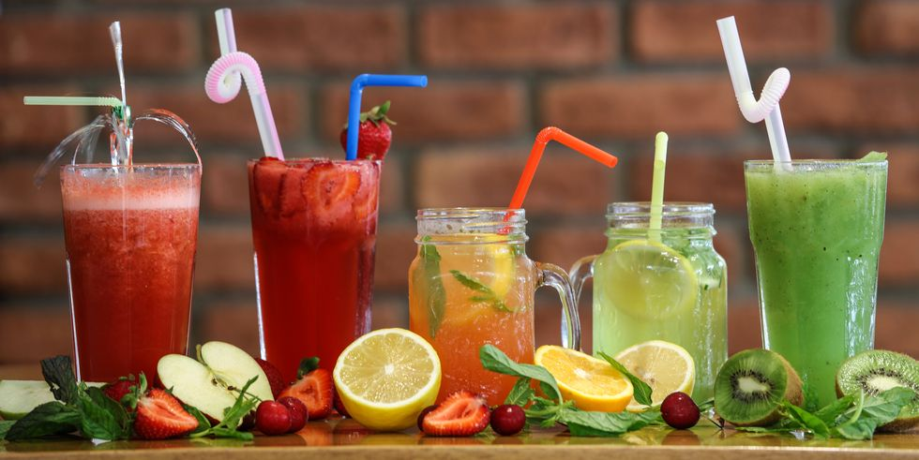
Trend Analysis
INTRO
INTRO
INTRO
INTRO
INTRO
INTRO
MARKETING
PROBLEM
MARKETING
PROBLEM
MARKETING
PROBLEM
MARKETING
PROBLEM
MARKETING
PROBLEM
MARKETING
PROBLEM
ADVERTISING
OBJECTIVE
ADVERTISING
OBJECTIVE
ADVERTISING
OBJECTIVE
ADVERTISING
OBJECTIVE
ADVERTISING
OBJECTIVE
ADVERTISING
OBJECTIVE
SITUATION ANALYSIS
SITUATION ANALYSIS
SITUATION ANALYSIS
SITUATION ANALYSIS
SITUATION ANALYSIS
SITUATION ANALYSIS
TREND
TREND
TREND
TREND
TREND
TREND
COMPETITIVE
COMPETITIVE
COMPETITIVE
COMPETITIVE
COMPETITIVE
COMPETITIVE
TARGET AUDIENCE
TARGET AUDIENCE
TARGET AUDIENCE
TARGET AUDIENCE
TARGET AUDIENCE
TARGET AUDIENCE
CONSUMER INSIGHTS
CONSUMER INSIGHTS
CONSUMER INSIGHTS
CONSUMER INSIGHTS
CONSUMER INSIGHTS
CONSUMER INSIGHTS
CREATIVE
BRIEF
CREATIVE
EXECUTION
CREATIVE
EXECUTION
CREATIVE
EXECUTION
CREATIVE
EXECUTION
CREATIVE
EXECUTION
CREATIVE
EXECUTION
MEDIA
PLAN
MEDIA
PLAN
MEDIA
PLAN
MEDIA
PLAN
MEDIA
PLAN
MEDIA
PLAN
Healthy consideration
With the emphasized on healthy lifestyles, consumers are overwhelmed with concerns about ingredients and supplements that can provide nutritional benefits.
New-generation tea-drinkers are actively seeking out for functional beverages such as protein-enriched or vitamin-added.
https://www.teaandcoffee.net/news/21796/tea-trends-2019/

Slide 10
Trend Analysis
INTRO
INTRO
INTRO
INTRO
INTRO
INTRO
MARKETING
PROBLEM
MARKETING
PROBLEM
MARKETING
PROBLEM
MARKETING
PROBLEM
MARKETING
PROBLEM
MARKETING
PROBLEM
ADVERTISING
OBJECTIVE
ADVERTISING
OBJECTIVE
ADVERTISING
OBJECTIVE
ADVERTISING
OBJECTIVE
ADVERTISING
OBJECTIVE
ADVERTISING
OBJECTIVE
SITUATION ANALYSIS
SITUATION ANALYSIS
SITUATION ANALYSIS
SITUATION ANALYSIS
SITUATION ANALYSIS
SITUATION ANALYSIS
TREND
TREND
TREND
TREND
TREND
TREND
COMPETITIVE
COMPETITIVE
COMPETITIVE
COMPETITIVE
COMPETITIVE
COMPETITIVE
TARGET AUDIENCE
TARGET AUDIENCE
TARGET AUDIENCE
TARGET AUDIENCE
TARGET AUDIENCE
TARGET AUDIENCE
CONSUMER INSIGHTS
CONSUMER INSIGHTS
CONSUMER INSIGHTS
CONSUMER INSIGHTS
CONSUMER INSIGHTS
CONSUMER INSIGHTS
CREATIVE
BRIEF
CREATIVE
EXECUTION
CREATIVE
EXECUTION
CREATIVE
EXECUTION
CREATIVE
EXECUTION
CREATIVE
EXECUTION
CREATIVE
EXECUTION
MEDIA
PLAN
MEDIA
PLAN
MEDIA
PLAN
MEDIA
PLAN
MEDIA
PLAN
MEDIA
PLAN
Convenience
Giving consumers the ease of drinking their products at the location of their choice with the instant satisfaction is expected. Ready-to-drink beverages are growing in popularity as they offer the grab-and-go convenience that fits into busy, yet healthy lifestyles.
Spiritual value
In this digital age, consumers are led by social media for almost everything they do. The experience economy has been extremely influential and resulting in customers looking for new ways to experience the things they enjoy.
https://www.teaandcoffee.net/news/21796/tea-trends-2019/
https://www.beveragedaily.com/Article/2018/12/05/Top-five-predictions-for-2019-beverage-trends

Slide 11
Trend Analysis
INTRO
INTRO
INTRO
INTRO
INTRO
MARKETING
PROBLEM
MARKETING
PROBLEM
MARKETING
PROBLEM
MARKETING
PROBLEM
MARKETING
PROBLEM
ADVERTISING
OBJECTIVE
ADVERTISING
OBJECTIVE
ADVERTISING
OBJECTIVE
ADVERTISING
OBJECTIVE
ADVERTISING
OBJECTIVE
SITUATION ANALYSIS
SITUATION ANALYSIS
SITUATION ANALYSIS
SITUATION ANALYSIS
SITUATION ANALYSIS
TREND
TREND
TREND
TREND
TREND
COMPETITIVE
COMPETITIVE
COMPETITIVE
COMPETITIVE
COMPETITIVE
TARGET AUDIENCE
TARGET AUDIENCE
TARGET AUDIENCE
TARGET AUDIENCE
TARGET AUDIENCE
CONSUMER INSIGHTS
CONSUMER INSIGHTS
CONSUMER INSIGHTS
CONSUMER INSIGHTS
CONSUMER INSIGHTS
CREATIVE
BRIEF
CREATIVE
EXECUTION
CREATIVE
EXECUTION
CREATIVE
EXECUTION
CREATIVE
EXECUTION
CREATIVE
EXECUTION
MEDIA
PLAN
MEDIA
PLAN
MEDIA
PLAN
MEDIA
PLAN
MEDIA
PLAN
Color
Consumers are looking for bright, bold hues in terms of colors. Young people have an eye for what drinks that are “Instagram-friendly”.
Sustainability
Plastic has come under fire in 2018, but consumers’ interest in sustainability is also much wider.
Social media complains about Snapple changing from glass bottles to plastic BPA-free bottles.
https://www.teaandcoffee.net/news/21796/tea-trends-2019/
https://www.beveragedaily.com/Article/2018/12/05/Top-five-predictions-for-2019-beverage-trends

Slide 12
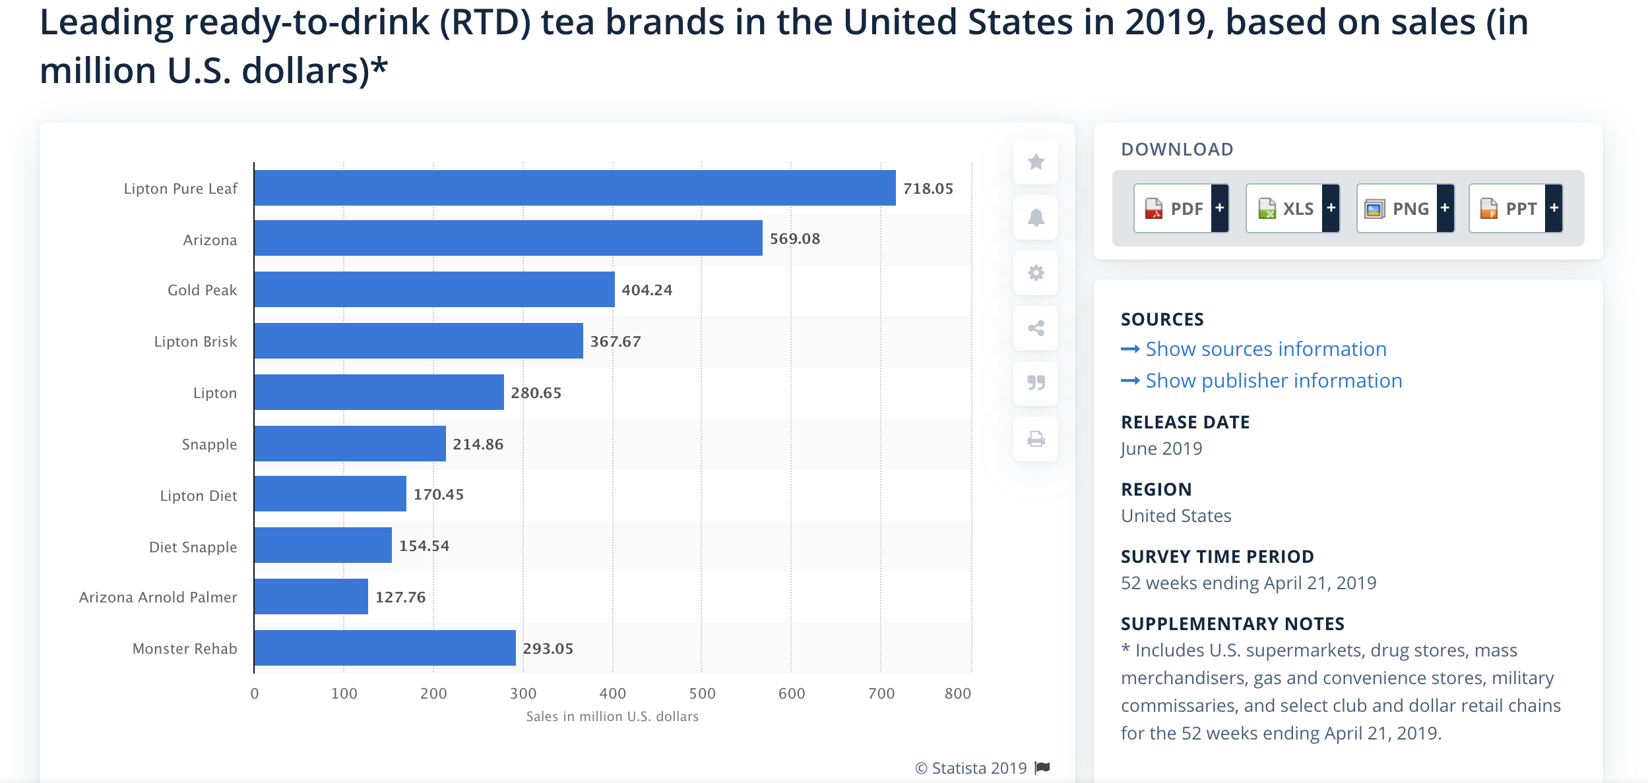
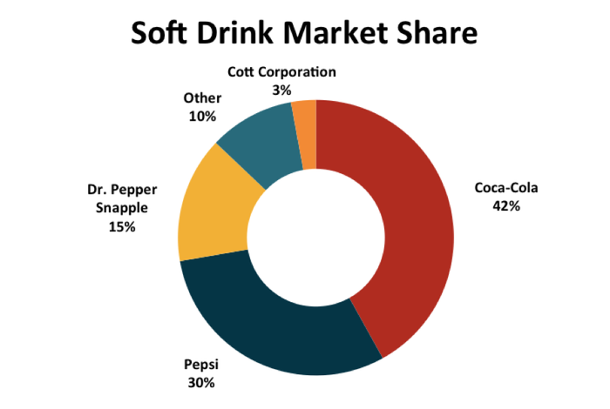
Competitive Analysis
INTRO
INTRO
INTRO
INTRO
INTRO
MARKETING
PROBLEM
MARKETING
PROBLEM
MARKETING
PROBLEM
MARKETING
PROBLEM
MARKETING
PROBLEM
ADVERTISING
OBJECTIVE
ADVERTISING
OBJECTIVE
ADVERTISING
OBJECTIVE
ADVERTISING
OBJECTIVE
ADVERTISING
OBJECTIVE
SITUATION ANALYSIS
SITUATION ANALYSIS
SITUATION ANALYSIS
SITUATION ANALYSIS
SITUATION ANALYSIS
TREND
TREND
TREND
TREND
TREND
COMPETITIVE
COMPETITIVE
COMPETITIVE
COMPETITIVE
COMPETITIVE
TARGET AUDIENCE
TARGET AUDIENCE
TARGET AUDIENCE
TARGET AUDIENCE
TARGET AUDIENCE
CONSUMER INSIGHTS
CONSUMER INSIGHTS
CONSUMER INSIGHTS
CONSUMER INSIGHTS
CONSUMER INSIGHTS
CREATIVE
BRIEF
CREATIVE
EXECUTION
CREATIVE
EXECUTION
CREATIVE
EXECUTION
CREATIVE
EXECUTION
CREATIVE
EXECUTION
MEDIA
PLAN
MEDIA
PLAN
MEDIA
PLAN
MEDIA
PLAN
MEDIA
PLAN
In 1996 Snapple controlled 21.4% of the tea market and 16.4% of the juice market. In 2014, Snapple's market share was at 9.3% for tea and 7.1% for juice.
https://www.statista.com
https://www.thrillist.com/drink/nation/
https://www.dallasnews.com

Slide 13
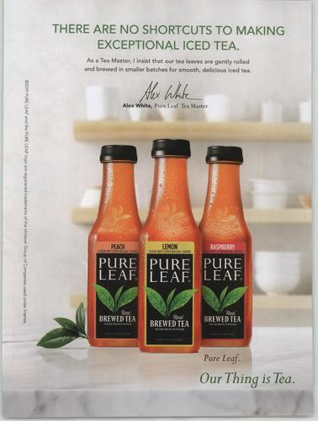
Pure Leaf
INTRO
INTRO
INTRO
INTRO
INTRO
MARKETING
PROBLEM
MARKETING
PROBLEM
MARKETING
PROBLEM
MARKETING
PROBLEM
MARKETING
PROBLEM
ADVERTISING
OBJECTIVE
ADVERTISING
OBJECTIVE
ADVERTISING
OBJECTIVE
ADVERTISING
OBJECTIVE
ADVERTISING
OBJECTIVE
SITUATION ANALYSIS
SITUATION ANALYSIS
SITUATION ANALYSIS
SITUATION ANALYSIS
SITUATION ANALYSIS
TREND
TREND
TREND
TREND
TREND
COMPETITIVE
COMPETITIVE
COMPETITIVE
COMPETITIVE
COMPETITIVE
TARGET AUDIENCE
TARGET AUDIENCE
TARGET AUDIENCE
TARGET AUDIENCE
TARGET AUDIENCE
CONSUMER INSIGHTS
CONSUMER INSIGHTS
CONSUMER INSIGHTS
CONSUMER INSIGHTS
CONSUMER INSIGHTS
CREATIVE
BRIEF
CREATIVE
EXECUTION
CREATIVE
EXECUTION
CREATIVE
EXECUTION
CREATIVE
EXECUTION
CREATIVE
EXECUTION
MEDIA
PLAN
MEDIA
PLAN
MEDIA
PLAN
MEDIA
PLAN
MEDIA
PLAN
Food Network Magazine on October, 2019
Headline: There are no shortcuts to making exceptional iced tea
Slogan: Our Thing is Tea
Key benefit: Good quality
Position guideline: Position by benefit
https://advertisers.mediaradar.com/pure-leaf-tea-advertising-profile
https://www.pureleaf.com/us

Slide 14
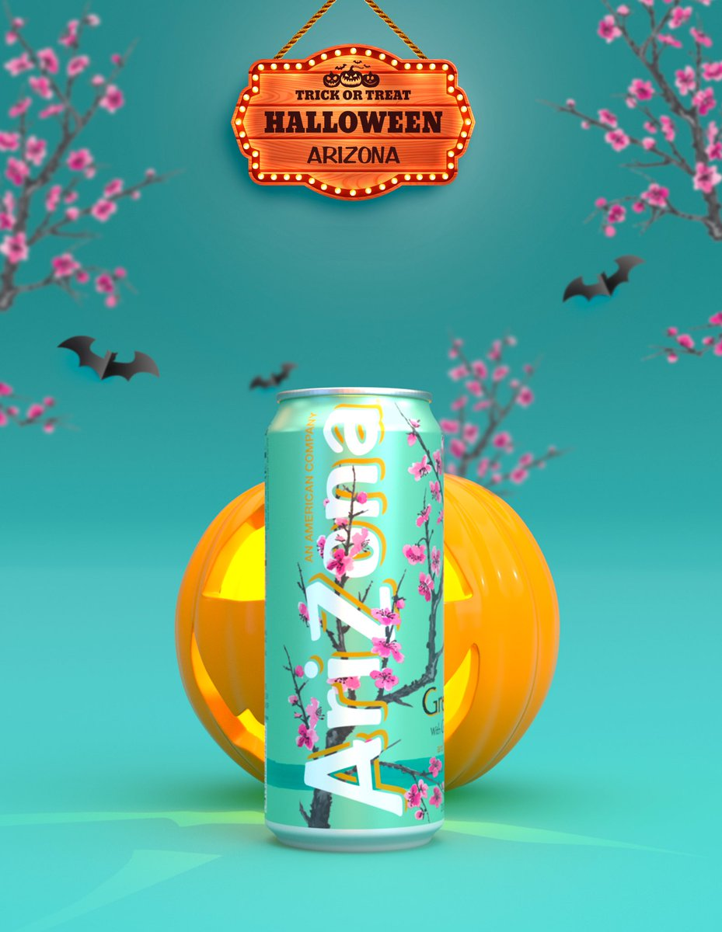
Arizona
INTRO
INTRO
INTRO
INTRO
INTRO
MARKETING
PROBLEM
MARKETING
PROBLEM
MARKETING
PROBLEM
MARKETING
PROBLEM
MARKETING
PROBLEM
ADVERTISING
OBJECTIVE
ADVERTISING
OBJECTIVE
ADVERTISING
OBJECTIVE
ADVERTISING
OBJECTIVE
ADVERTISING
OBJECTIVE
SITUATION ANALYSIS
SITUATION ANALYSIS
SITUATION ANALYSIS
SITUATION ANALYSIS
SITUATION ANALYSIS
TREND
TREND
TREND
TREND
TREND
COMPETITIVE
COMPETITIVE
COMPETITIVE
COMPETITIVE
COMPETITIVE
TARGET AUDIENCE
TARGET AUDIENCE
TARGET AUDIENCE
TARGET AUDIENCE
TARGET AUDIENCE
CONSUMER INSIGHTS
CONSUMER INSIGHTS
CONSUMER INSIGHTS
CONSUMER INSIGHTS
CONSUMER INSIGHTS
CREATIVE
BRIEF
CREATIVE
EXECUTION
CREATIVE
EXECUTION
CREATIVE
EXECUTION
CREATIVE
EXECUTION
CREATIVE
EXECUTION
MEDIA
PLAN
MEDIA
PLAN
MEDIA
PLAN
MEDIA
PLAN
MEDIA
PLAN
Twitter on October 31, 2019
Headline - Trick or Treat Halloween Arizona
Slogan - The Fresher The Better
Key benefit - interesting / fun
Position guideline - Position by price (99 cents / bottle)
https://www.drinkarizona.com/
Twitter @DrinkAriZona

Slide 15
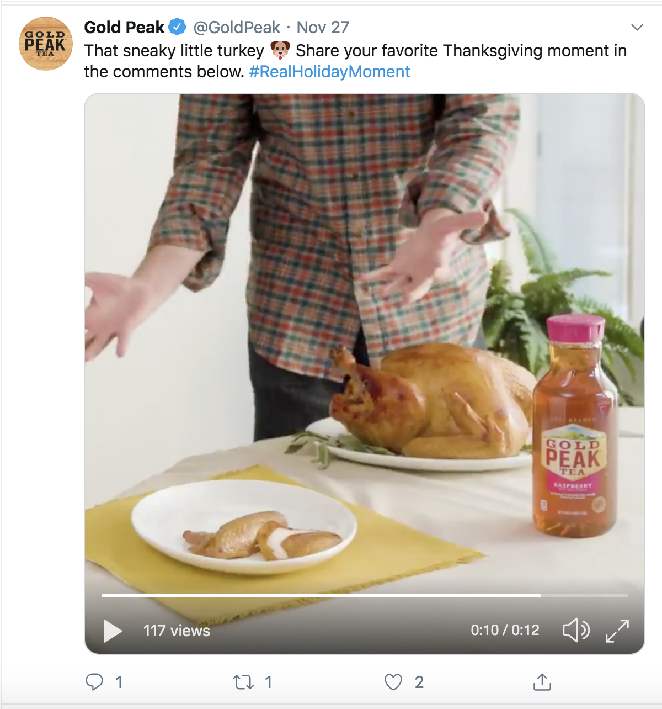
Gold Peak
INTRO
INTRO
INTRO
INTRO
MARKETING
PROBLEM
MARKETING
PROBLEM
MARKETING
PROBLEM
MARKETING
PROBLEM
ADVERTISING
OBJECTIVE
ADVERTISING
OBJECTIVE
ADVERTISING
OBJECTIVE
ADVERTISING
OBJECTIVE
SITUATION ANALYSIS
SITUATION ANALYSIS
SITUATION ANALYSIS
SITUATION ANALYSIS
TREND
TREND
TREND
TREND
COMPETITIVE
COMPETITIVE
COMPETITIVE
COMPETITIVE
TARGET AUDIENCE
TARGET AUDIENCE
TARGET AUDIENCE
TARGET AUDIENCE
CONSUMER INSIGHTS
CONSUMER INSIGHTS
CONSUMER INSIGHTS
CONSUMER INSIGHTS
CREATIVE
BRIEF
CREATIVE
EXECUTION
CREATIVE
EXECUTION
CREATIVE
EXECUTION
CREATIVE
EXECUTION
MEDIA
PLAN
MEDIA
PLAN
MEDIA
PLAN
MEDIA
PLAN
Twitter on November 27, 2019
Hashtag: Real Holiday Moment
Slogan: The taste that brings you home
Headline - That sneaky little turkey
Key benefit: connect brand with holidays and create product usage scenarios
Position guideline: Position by use
https://www.goldpeakbeverages.com/
Twitter @GoldPeak

Slide 16
Target Audience, Part 1
INTRO
INTRO
INTRO
INTRO
MARKETING
PROBLEM
MARKETING
PROBLEM
MARKETING
PROBLEM
MARKETING
PROBLEM
ADVERTISING
OBJECTIVE
ADVERTISING
OBJECTIVE
ADVERTISING
OBJECTIVE
ADVERTISING
OBJECTIVE
SITUATION ANALYSIS
SITUATION ANALYSIS
SITUATION ANALYSIS
SITUATION ANALYSIS
TREND
TREND
TREND
TREND
COMPETITIVE
COMPETITIVE
COMPETITIVE
COMPETITIVE
TARGET AUDIENCE
TARGET AUDIENCE
TARGET AUDIENCE
TARGET AUDIENCE
CONSUMER INSIGHTS
CONSUMER INSIGHTS
CONSUMER INSIGHTS
CONSUMER INSIGHTS
CREATIVE
BRIEF
CREATIVE
EXECUTION
CREATIVE
EXECUTION
CREATIVE
EXECUTION
CREATIVE
EXECUTION
MEDIA
PLAN
MEDIA
PLAN
MEDIA
PLAN
MEDIA
PLAN
Males and females between the age of 18 and 24
Demo MRI lifestyle (based on MRI index, percentage, and research)
Value experience
Willing to spend money just for fun
Heavy users of social media
Subscribers of music, fashion, entertainment channels, accounts or publications
Value the sense of humor

Slide 17
Target Audience, Part 2
INTRO
INTRO
INTRO
INTRO
MARKETING
PROBLEM
MARKETING
PROBLEM
MARKETING
PROBLEM
MARKETING
PROBLEM
ADVERTISING
OBJECTIVE
ADVERTISING
OBJECTIVE
ADVERTISING
OBJECTIVE
ADVERTISING
OBJECTIVE
SITUATION ANALYSIS
SITUATION ANALYSIS
SITUATION ANALYSIS
SITUATION ANALYSIS
TREND
TREND
TREND
TREND
COMPETITIVE
COMPETITIVE
COMPETITIVE
COMPETITIVE
TARGET AUDIENCE
TARGET AUDIENCE
TARGET AUDIENCE
TARGET AUDIENCE
CONSUMER INSIGHTS
CONSUMER INSIGHTS
CONSUMER INSIGHTS
CONSUMER INSIGHTS
CREATIVE
BRIEF
CREATIVE
EXECUTION
CREATIVE
EXECUTION
CREATIVE
EXECUTION
CREATIVE
EXECUTION
MEDIA
PLAN
MEDIA
PLAN
MEDIA
PLAN
MEDIA
PLAN
The problem that needs to be solved: Young people view Snapple as an old fashioned beverage brand
The benefit: Snapple gives fun facts on the cap that makes the brand interesting and left impressions on its consumers.
Support: (based on Primary and Secondary research)
#sanpplefacts as 103K post on Instagram and it’s also a trend on other social media Facebook
Based on the one-on-one interviews and internet survey, 75% of Snapple consumers mention the Snapple Facts on the caps
“Snapple is an ice tea brand filled of Childhood memories, but I seldom drink it nowadays,” said Congxiao Wang, a Snapple consumer.
Brand Personality: Snapple is known as “Real Facts” under the cap. Instead of the traditional Snapple Lady icon, Snapple has characteristics of interesting and funny. Therefore, Snapple can be pictured as a chubby knowledgeable man with glasses who always has a giant book with him, like to tell people useless but real fun facts about the world.
https://www.instagram.com/snapple/?hl=en

Slide 18
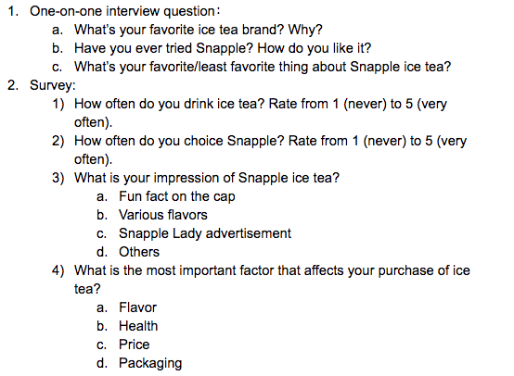
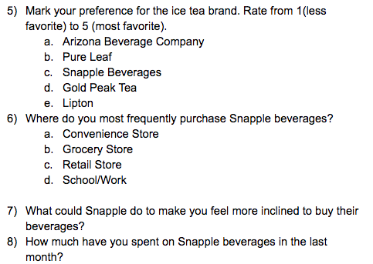
Interview and Survey
INTRO
INTRO
INTRO
MARKETING
PROBLEM
MARKETING
PROBLEM
MARKETING
PROBLEM
ADVERTISING
OBJECTIVE
ADVERTISING
OBJECTIVE
ADVERTISING
OBJECTIVE
SITUATION ANALYSIS
SITUATION ANALYSIS
SITUATION ANALYSIS
TREND
TREND
TREND
COMPETITIVE
COMPETITIVE
COMPETITIVE
TARGET AUDIENCE
TARGET AUDIENCE
TARGET AUDIENCE
CONSUMER INSIGHTS
CONSUMER INSIGHTS
CONSUMER INSIGHTS
CREATIVE
BRIEF
CREATIVE
EXECUTION
CREATIVE
EXECUTION
CREATIVE
EXECUTION
MEDIA
PLAN
MEDIA
PLAN
MEDIA
PLAN

Slide 19
Consumer Thoughts
INTRO
INTRO
MARKETING
PROBLEM
MARKETING
PROBLEM
ADVERTISING
OBJECTIVE
ADVERTISING
OBJECTIVE
SITUATION ANALYSIS
SITUATION ANALYSIS
TREND
TREND
COMPETITIVE
COMPETITIVE
TARGET AUDIENCE
TARGET AUDIENCE
CONSUMER INSIGHTS
CONSUMER INSIGHTS
CREATIVE
BRIEF
CREATIVE
EXECUTION
CREATIVE
EXECUTION
MEDIA
PLAN
MEDIA
PLAN
Observation: People who like the experience of drinking ice tea also tend to be Subscribers of music, fashion, entertainment channels, who enjoy funny and interesting things
Consumer fact: Snapple is a traditional juice and ice tea brand on the mind of our target audience.
Insight: Snapple keep provides fun facts and interesting lines on the cap that give their consumer a break to relax.
Quotes:
“Snapple is an ice tea brand filled of Childhood memories, but I seldom drink it nowadays,” said Congxiao Wang, a Snapple consumer.
“I like the fun fact that Snapple gave, and it’s kinda cute,” said Fang Wang, a Snapple consumer.
“ I drink iced tea when I'm taking a break,” Danni Huang, a Snapple consumer.

Slide 20
Creative Brief
INTRO
MARKETING
PROBLEM
ADVERTISING
OBJECTIVE
SITUATION ANALYSIS
TREND
COMPETITIVE
TARGET AUDIENCE
CONSUMER INSIGHTS
CREATIVE
BRIEF
CREATIVE
EXECUTION
MEDIA
PLAN
Marketing Problem
Snapple was once the leading competitor in the ready-to-drink iced tea category. Heightened competition and diminishing media presence has caused consumers to overlook Snapple for more contemporary iced tea brands.
Advertising Objective
Change consumer perception of Snapple to be more positive and fashion.
Target Audience
Males and females between 18 to 24.
Value experience, willing to spend money just for fun.
Heavy users of social media, subscribers of music, fashion, entertainment channels, accounts or publications.

Slide 21
Creative Brief
INTRO
MARKETING
PROBLEM
ADVERTISING
OBJECTIVE
SITUATION ANALYSIS
TREND
COMPETITIVE
TARGET AUDIENCE
CONSUMER INSIGHTS
CREATIVE
BRIEF
CREATIVE
EXECUTION
MEDIA
PLAN
Benefit
The real facts from the ice tea bottle cap are interesting and worth discussing with friends.
Support for Benefit
For the target audience, the real facts on the bottle caps relax them during class or work break; they are able to share what facts they get with friends. It stimulates the curiosity of consumers to try more Snapple drinks, learning more fun facts.
Brand Personality
A short, chubby man with glasses who always has a giant book with him, like to tell people useless but real fun facts about the world.

Slide 22
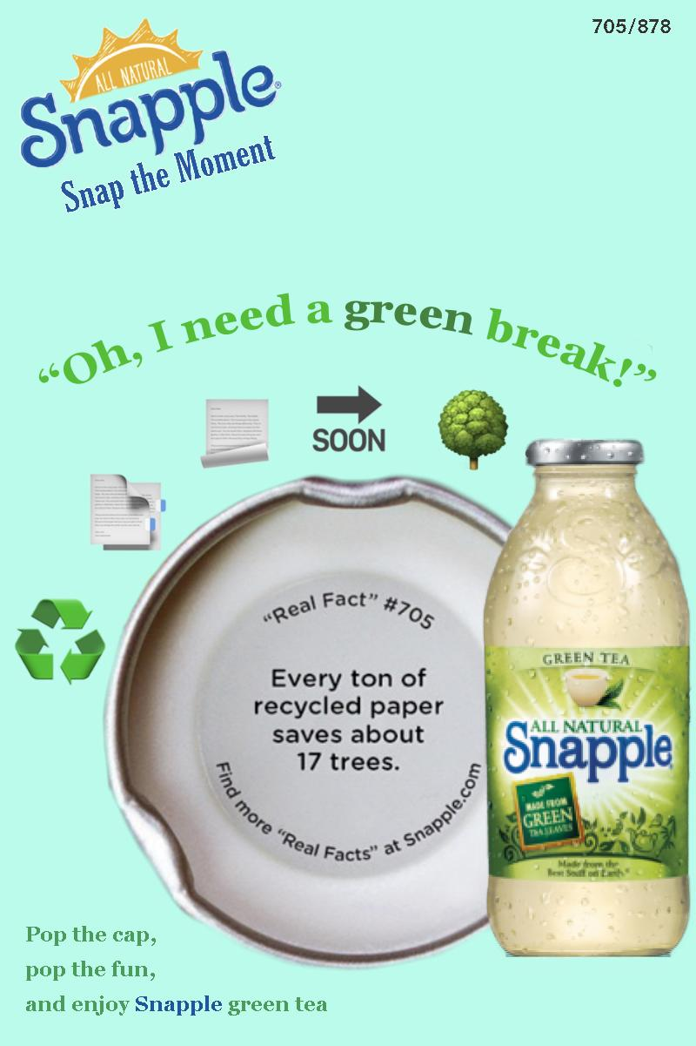
Creative execution
magazine ad 1
INTRO
MARKETING
PROBLEM
ADVERTISING
OBJECTIVE
SITUATION ANALYSIS
TREND
COMPETITIVE
TARGET AUDIENCE
CONSUMER INSIGHTS
CREATIVE
BRIEF
CREATIVE
EXECUTION
MEDIA
PLAN

Slide 23
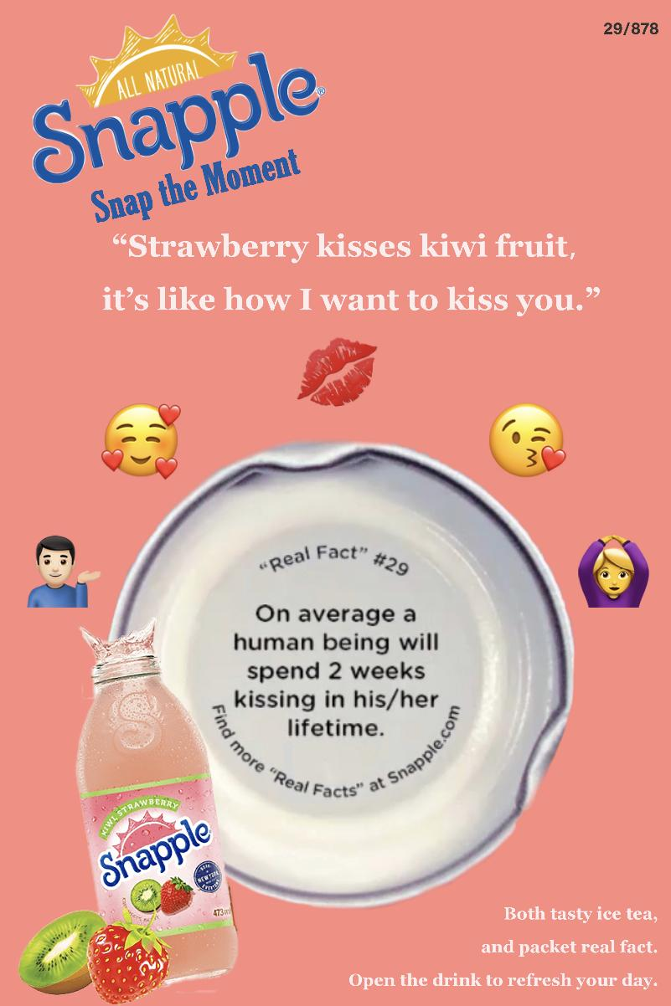
Creative execution
magazine ad 2
INTRO
INTRO
MARKETING
PROBLEM
MARKETING
PROBLEM
ADVERTISING
OBJECTIVE
ADVERTISING
OBJECTIVE
SITUATION ANALYSIS
SITUATION ANALYSIS
TREND
TREND
COMPETITIVE
COMPETITIVE
TARGET AUDIENCE
TARGET AUDIENCE
CONSUMER INSIGHTS
CONSUMER INSIGHTS
CREATIVE
BRIEF
CREATIVE
EXECUTION
CREATIVE
EXECUTION
MEDIA
PLAN
MEDIA
PLAN

Slide 24
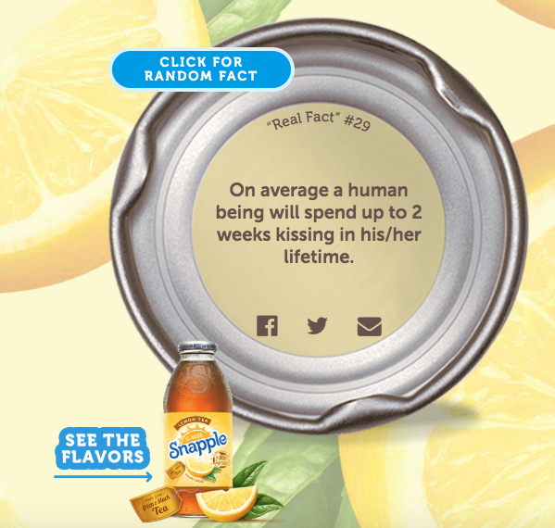
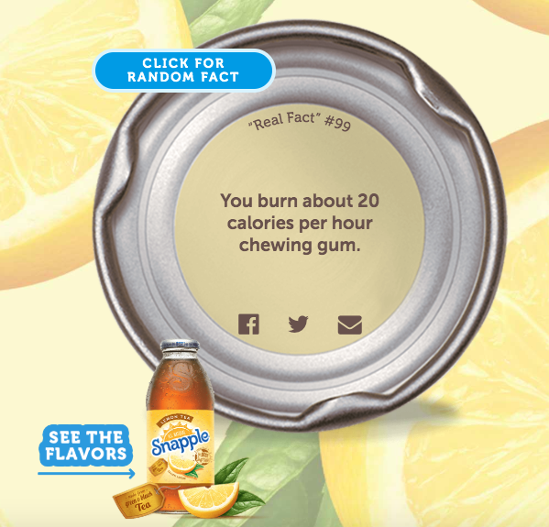
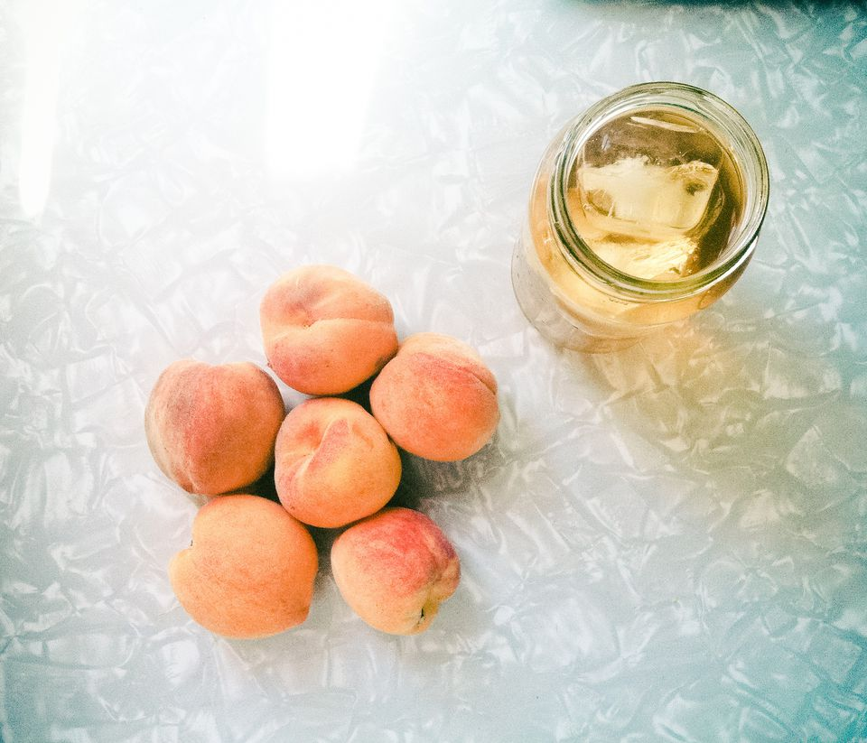
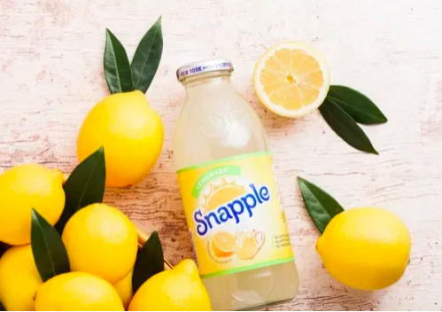
Creative Execution - Twitter (Social Media)
INTRO
INTRO
MARKETING
PROBLEM
MARKETING
PROBLEM
ADVERTISING
OBJECTIVE
ADVERTISING
OBJECTIVE
SITUATION ANALYSIS
SITUATION ANALYSIS
TREND
TREND
COMPETITIVE
COMPETITIVE
TARGET AUDIENCE
TARGET AUDIENCE
CONSUMER INSIGHTS
CONSUMER INSIGHTS
CREATIVE
BRIEF
CREATIVE
EXECUTION
CREATIVE
EXECUTION
MEDIA
PLAN
MEDIA
PLAN
Temporary Trends
Holiday / Special Date
#SnappleRealFact Hawaii is the only U.S. state never to report a temperature of zero degrees F or below.
Let’s keep the SUMMER in your cup! #temperaturedrops
#SnappleRealFact On average a human being will spend 2 WEEKS kissing in his lifetime.
Jesus! How many girlfriends do you guys have to make it? Cause I have none. #SinglesDay

Slide 25
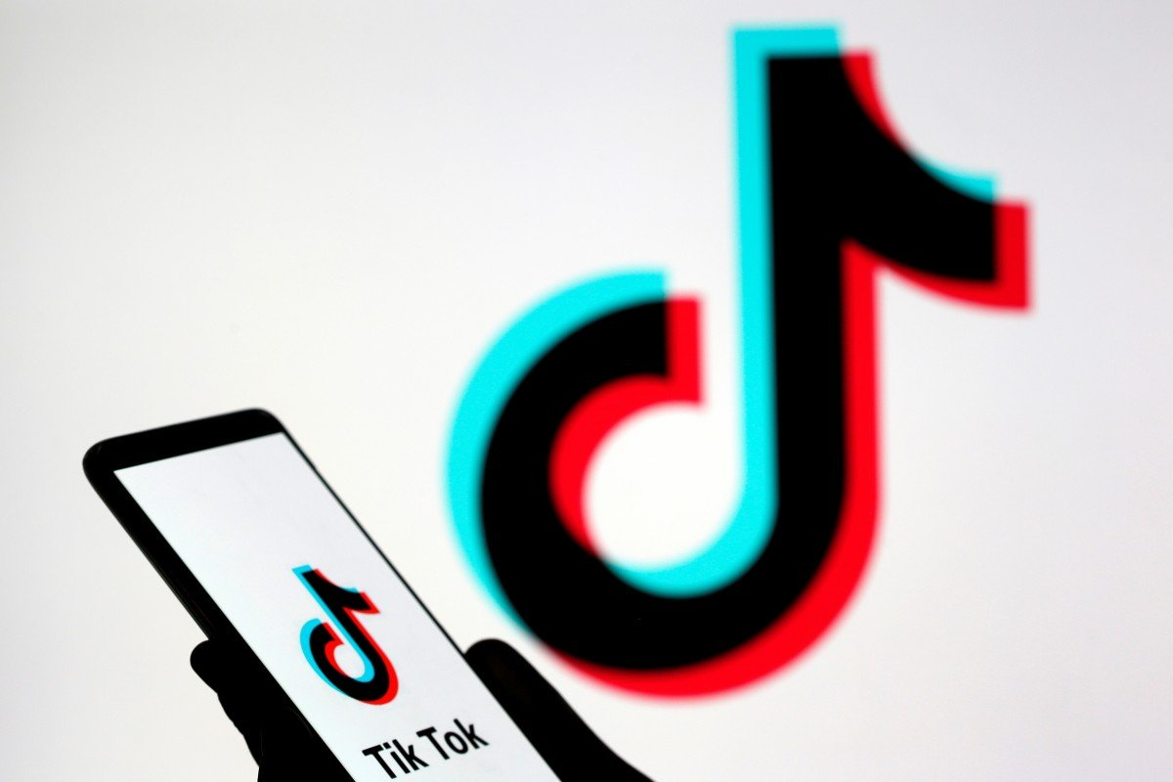
Creative Execution - Tik Tok Campaign
INTRO
INTRO
MARKETING
PROBLEM
MARKETING
PROBLEM
ADVERTISING
OBJECTIVE
ADVERTISING
OBJECTIVE
SITUATION ANALYSIS
SITUATION ANALYSIS
TREND
TREND
COMPETITIVE
COMPETITIVE
TARGET AUDIENCE
TARGET AUDIENCE
CONSUMER INSIGHTS
CONSUMER INSIGHTS
CREATIVE
BRIEF
CREATIVE
EXECUTION
CREATIVE
EXECUTION
MEDIA
PLAN
MEDIA
PLAN
“Snap the moment Share fun real facts”
Collaborate with TikTok, initiates a campaign to encourage users to “snap”short videos with Snapple and share their fun real fact.
Tag #Snapple to win the opportunity to Maldives for free during wintertime.
TikTok is a video-sharing social networking service owned by ByteDance. It is used to create short lip-sync, comedy, and talent videos. In February 2019, TikTok, together with Douyin, hit one billion downloads globally. This app now is extremely popular among the young.
https://en.wikipedia.org/wiki/TikTok

Slide 26
Media Plan - Print Ad
INTRO
INTRO
MARKETING
PROBLEM
MARKETING
PROBLEM
ADVERTISING
OBJECTIVE
ADVERTISING
OBJECTIVE
SITUATION ANALYSIS
SITUATION ANALYSIS
TREND
TREND
COMPETITIVE
COMPETITIVE
TARGET AUDIENCE
TARGET AUDIENCE
CONSUMER INSIGHTS
CONSUMER INSIGHTS
CREATIVE
BRIEF
CREATIVE
EXECUTION
CREATIVE
EXECUTION
MEDIA
PLAN
MEDIA
PLAN
Execution | Media | Reason | Time
Print Ad 1 | Magazines: Inc. | Magazines have High-quality graphics and reproduction, which makes it a suitable media choice. Inc. magazine has a index of 188 based on the Snapple MRI data. | July. 30th -Due to highest sales during a year -Start of the summer vacation
Print Ad 2 | Magazines: Food & Wine | Food & Wine magazine has a index of 177 based on the Snapple MRI data. Magazine contents of new experiences and trends match the lifestyle of target audience. | Holiday season: Valentine’s Day Christmas

Slide 27
Media Plan - Social Media & Campaign
INTRO
INTRO
INTRO
MARKETING
PROBLEM
MARKETING
PROBLEM
MARKETING
PROBLEM
ADVERTISING
OBJECTIVE
ADVERTISING
OBJECTIVE
ADVERTISING
OBJECTIVE
SITUATION ANALYSIS
SITUATION ANALYSIS
SITUATION ANALYSIS
TREND
TREND
TREND
COMPETITIVE
COMPETITIVE
COMPETITIVE
TARGET AUDIENCE
TARGET AUDIENCE
TARGET AUDIENCE
CONSUMER INSIGHTS
CONSUMER INSIGHTS
CONSUMER INSIGHTS
CREATIVE
BRIEF
CREATIVE
EXECUTION
CREATIVE
EXECUTION
CREATIVE
EXECUTION
MEDIA
PLAN
MEDIA
PLAN
MEDIA
PLAN
Execution | Media | Reason | Time
Social Media | Twitter | Huge user population. Tags are common and effective. Good platform to share text rather than emphasize on images. Quick sharing and easy retweets can make the concept become a virus. | End of August Relate to temperature drop
 |  |  | 11/11 Singles' Day
Tiktok Campaign | TikTok | The platform has a large population of young users. Short videos are engaging, fun and creative. It is a current trend and also easy to get users to engage with the brand. Platform has the culture of encouraging creative UGC. | October - November The prize is a free trip to Maldives during winter.

Slide 28
Thank
You
INTRO
MARKETING
PROBLEM
ADVERTISING
OBJECTIVE
SITUATION ANALYSIS
TREND
COMPETITIVE
TARGET AUDIENCE
CONSUMER INSIGHTS
CREATIVE
BRIEF
CREATIVE
EXECUTION
MEDIA
PLAN
Group 3: Dan Lou, Xinyi Wu, Minna Fang, Jiaxin Liu

